Slide 1
Single Cell RNA Sequencing
Chris Ozeroff
Short Read 2023

Slide 2
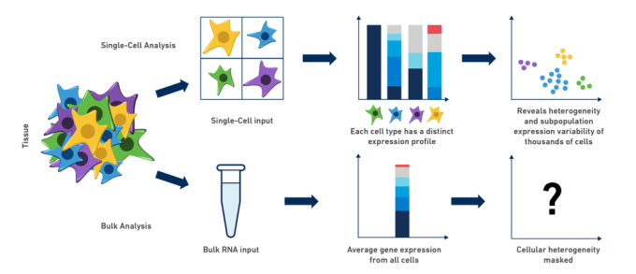
Single Cell RNA Sequencing

Slide 3
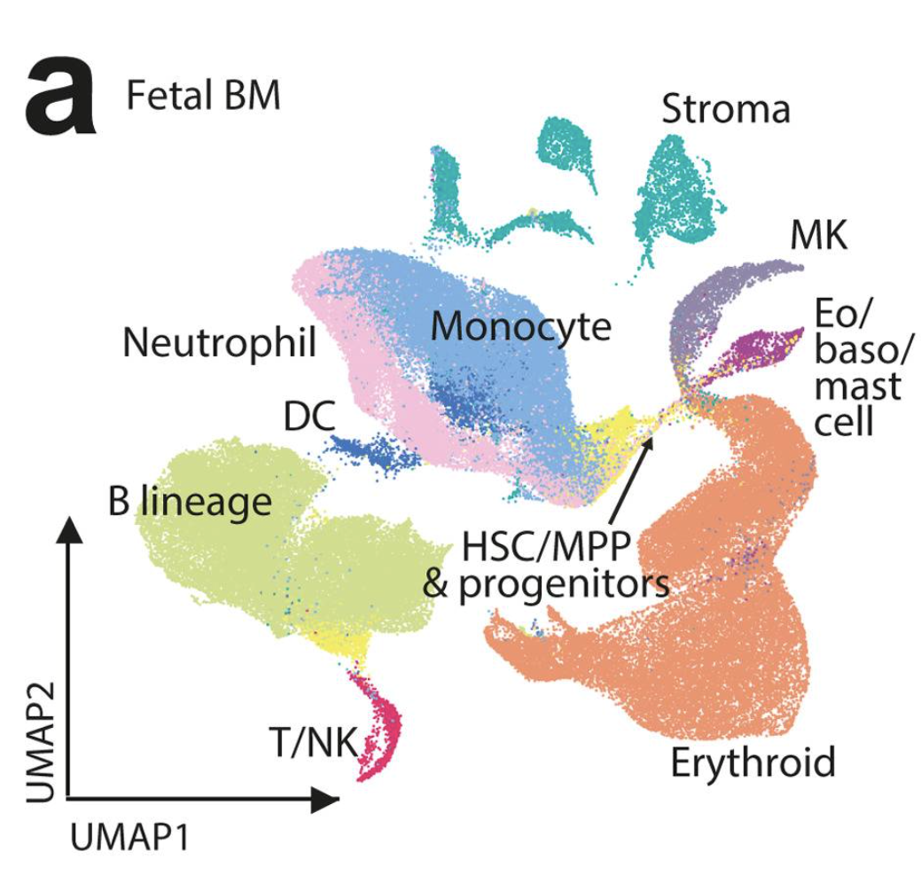
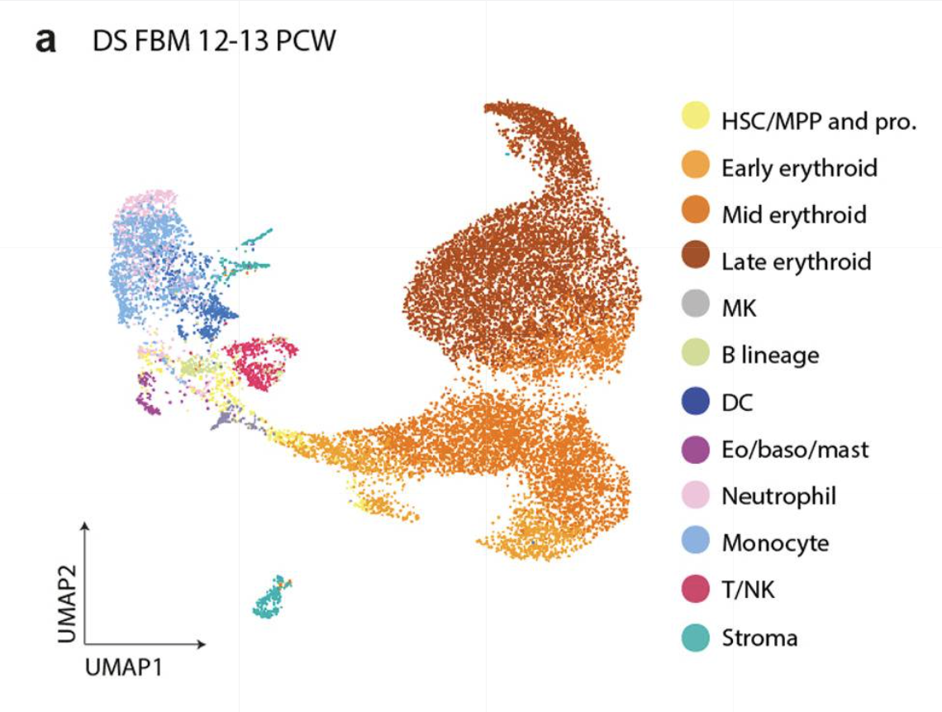
Down Syndrome vs. Typical Fetal Bone Marrow
A. Ranzoni 2021

Slide 4
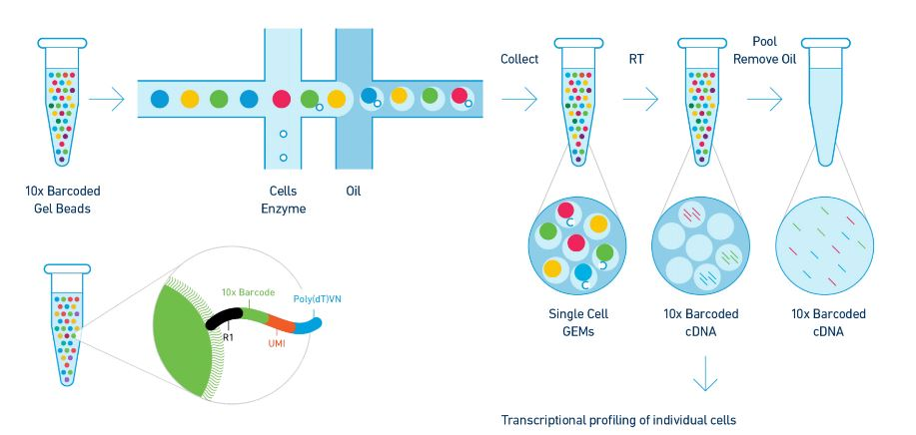
10X Genomics Droplet Method and Cell Ranger
Genomics Technology Core,
University of Missouri, 2021

Slide 5
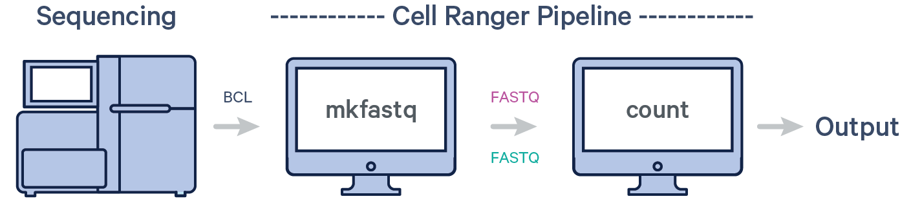
10X Genomics Droplet Method and Cell Ranger
Genomics Technology Core,
University of Missouri, 2021

Slide 6
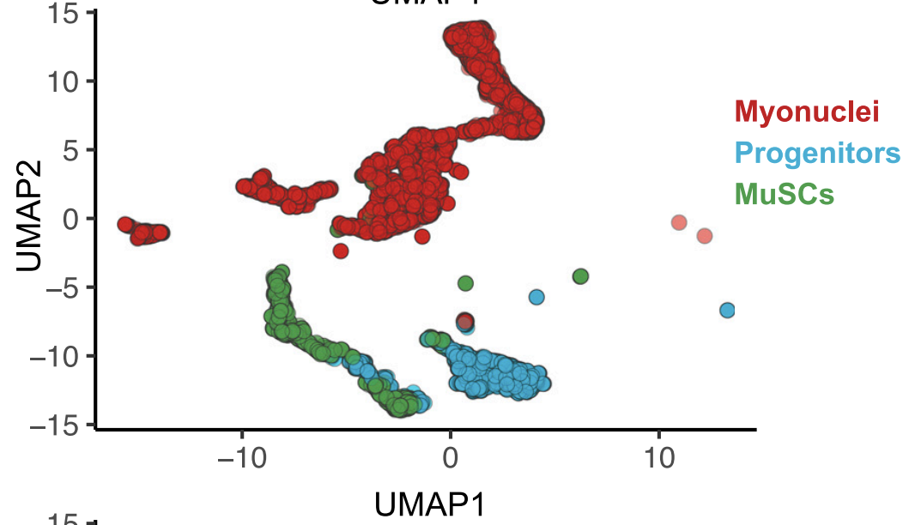
scRNA-seq workflow
Alignment
Normalization, scaling, dimensional reduction
Cluster visualization, differential expression, additional analysis
Pathways, pseudotime, velocity, etc.
Cellranger
Seurat (R)

Slide 7
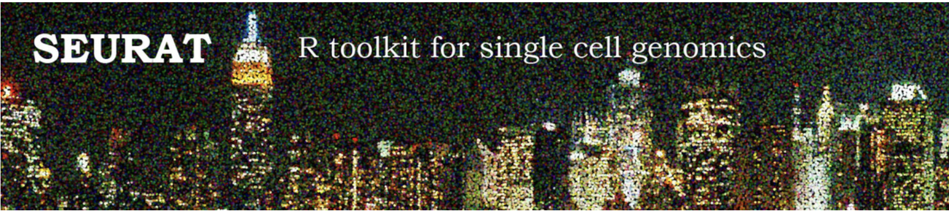
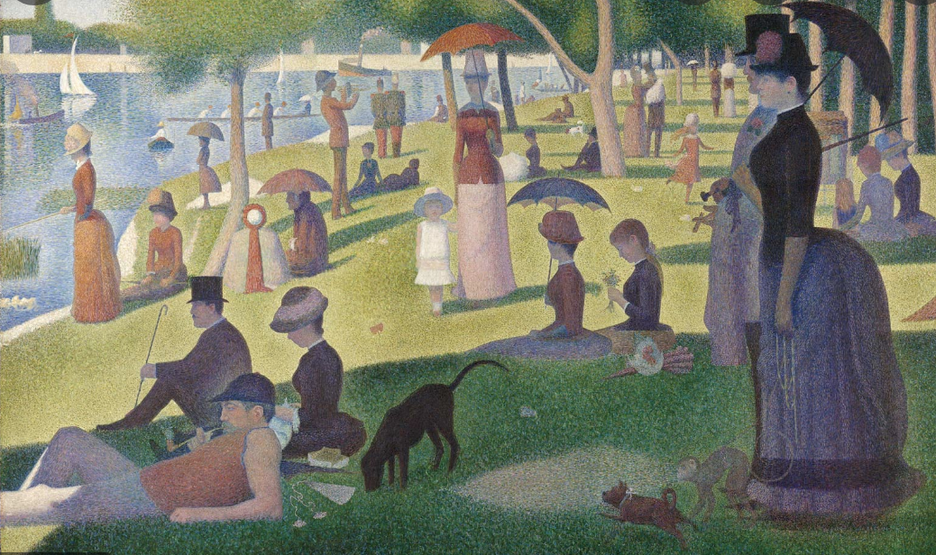
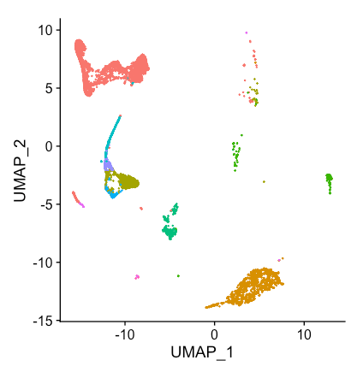
Seurat
Remove debris/doublets
A Sunday Afternoon on the Island of La Grande Jatte, Georges Seurat (1884)
Normalization
Scaledata
Myonuclei
“…named for Georges Seurat to invoke the analogy between the intricate spatial patterning of single cells and a pointillist painting.” (doi: 10.1038/nbt.3192)
PCA
Stem
cells
Immune
UMAP/clustering
Schwann
Smooth
muscle
FAPs

Slide 8
Seurat workflow
Processing individual
Seurat objects
Integrating
Seurat objects
Plotting and clustering
Add metadata
Merge Seurat objects
Normalize data
Find genes with variable gene expression
Scale data
Run PCA reduction
Split Seurat objects and identify anchors (genes) to “integrate” objects
UMAP reduction and visualization

